Slide 1

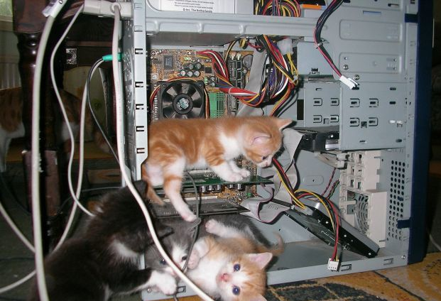
Introduction to Computer Science
Shimon Schocken
RUNI
Lecture 6-1
Computer Fundamentals
Part I
Notes:
‹#›

Slide 2

Overview
Goals: Explore...
How computers work
Low-level programming
The road from the low-level to the high level
computer
Approach
Introduce a simple computer
Write some machine language programs
Understand the hardware / software interplay, hands-on.

Slide 3
Lecture plan
Computer (Vic)
Architecture
Instructions
Low-level programming
Basic
Branching
Control
Program translation
From Vic to a real computer

Slide 4
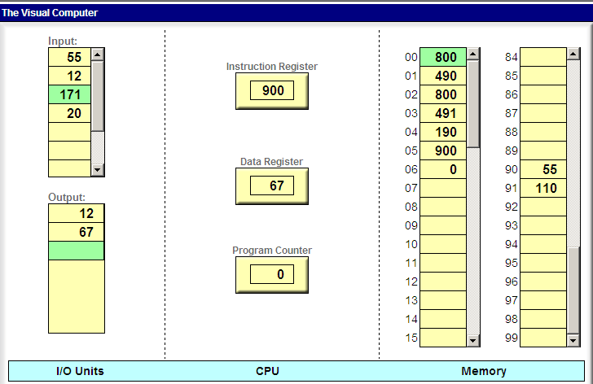
Vic: a simple computer architecture
0
1

Slide 5
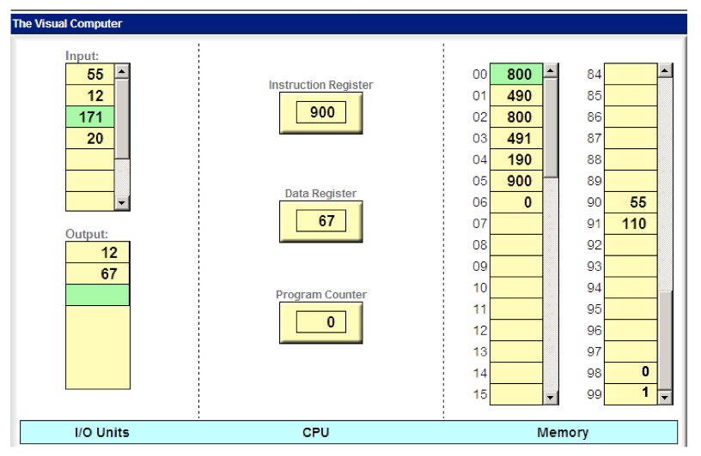
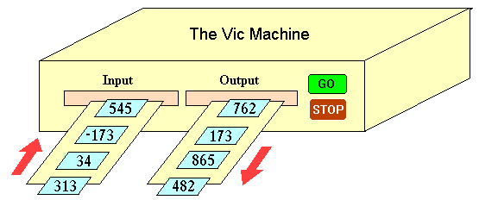

Vic: a simple computer architecture
inside view
outside view
instruction set
Hmmm … How
can I make this thing do some useful things?
read
write
load
store
add
sub
...

Slide 6
Data bus
read from input
load from memory
write to output
store to memory
0
1

Slide 7
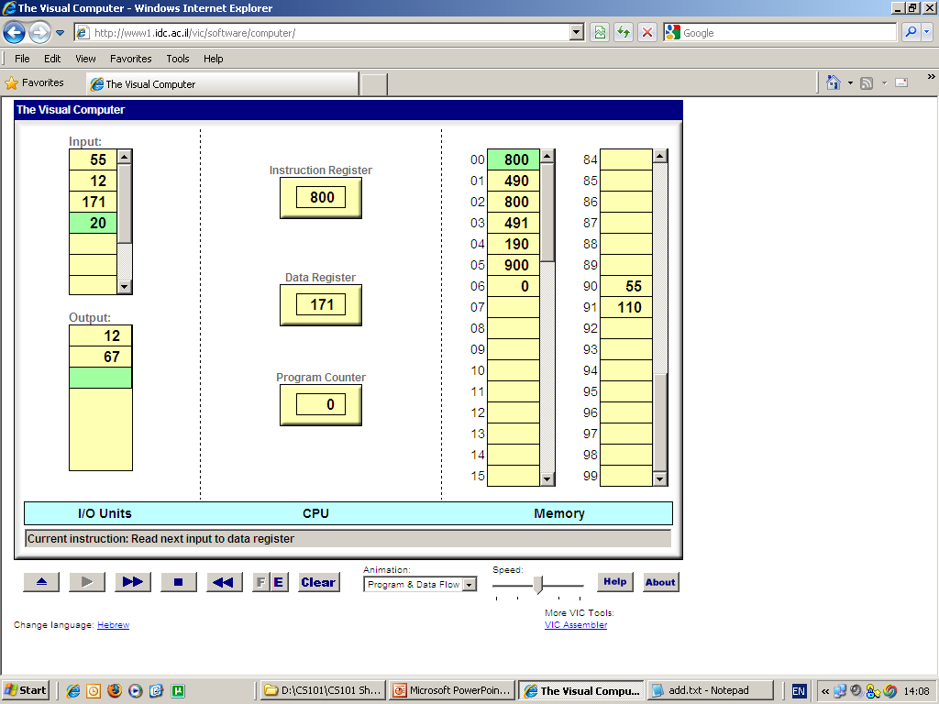
Instruction set
symbolic numeric semantics
syntax syntax (meaning)
read 800 D = input
write 900 output = D
load xx 3xx D = M[xx]
store xx 4xx M[xx] = D
add xx 1xx D = D + M[xx]
sub xx 2xx D = D - M[xx]
(D = the Data register)

Slide 8
Read operation
symbolic numeric semantics
syntax syntax (meaning)
read 800 D = input
write 900 output = D
load xx 3xx D = M[xx]
store xx 4xx M[xx] = D
read
add xx 1xx D = D + M[xx]
sub xx 2xx D = D - M[xx]
(D = the Data register)
following
execution:

Slide 9
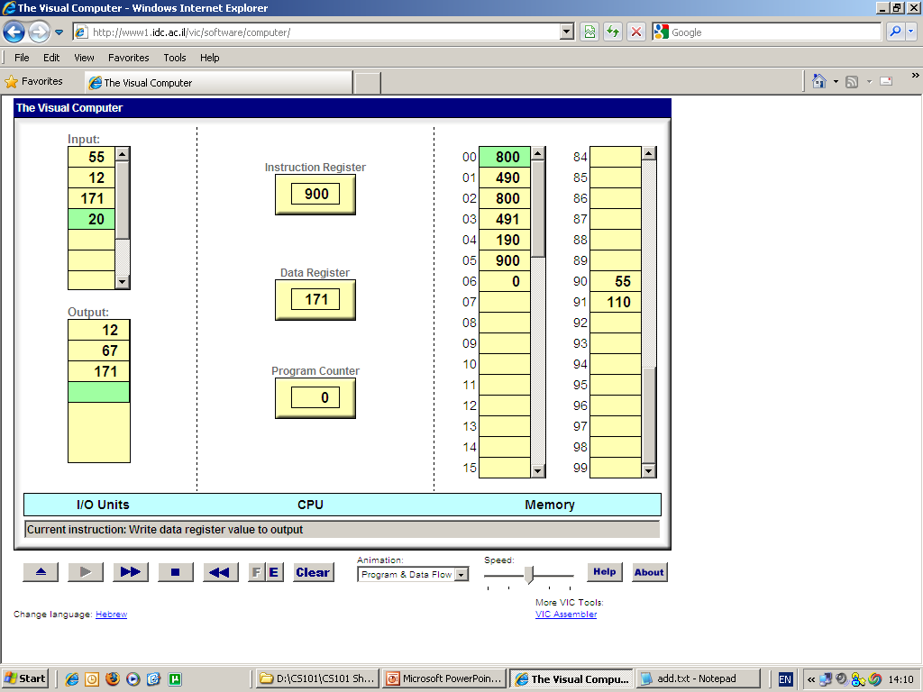
Write operation
symbolic numeric semantics
syntax syntax (meaning)
read 800 D = input
write 900 output = D
load xx 3xx D = M[xx]
store xx 4xx M[xx] = D
write
add xx 1xx D = D + M[xx]
sub xx 2xx D = D - M[xx]
(D = the Data register)
following
execution:

Slide 10
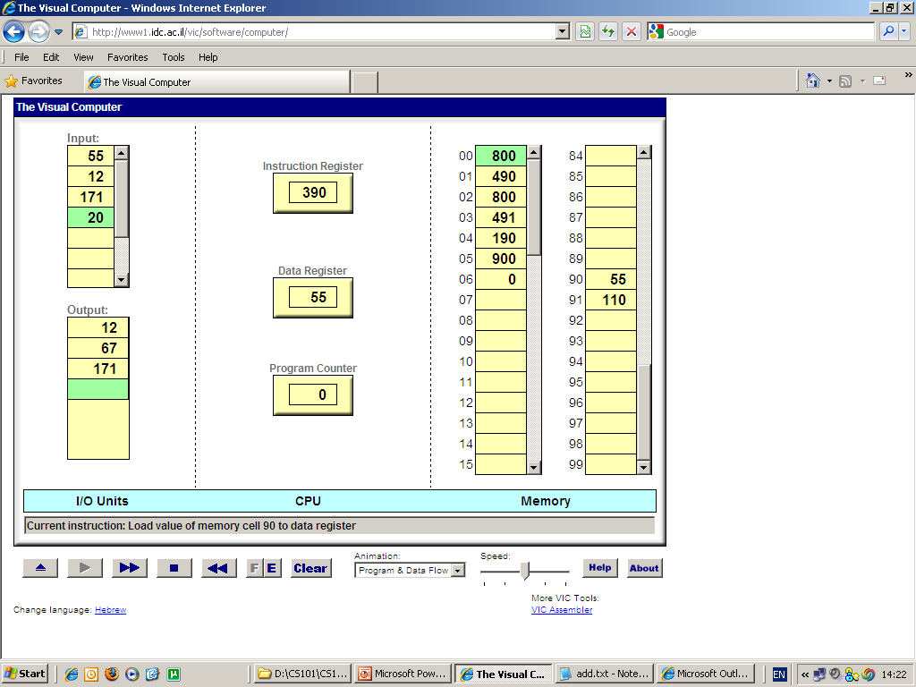
Load operation
symbolic numeric semantics
syntax syntax (meaning)
read 800 D = input
write 900 output = D
load xx 3xx D = M[xx]
store xx 4xx M[xx] = D
load 90
add xx 1xx D = D + M[xx]
sub xx 2xx D = D - M[xx]
(D = the Data register)
following
execution:

Slide 11
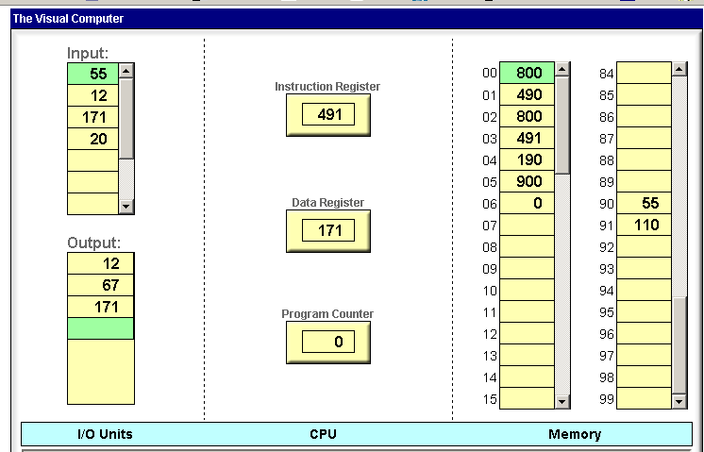

Store operation
symbolic numeric semantics
syntax syntax (meaning)
read 800 D = input
write 900 output = D
load xx 3xx D = M[xx]
store xx 4xx M[xx] = D
store 91
add xx 1xx D = D + M[xx]
sub xx 2xx D = D - M[xx]
(D = the Data register)
following
execution:

Slide 12
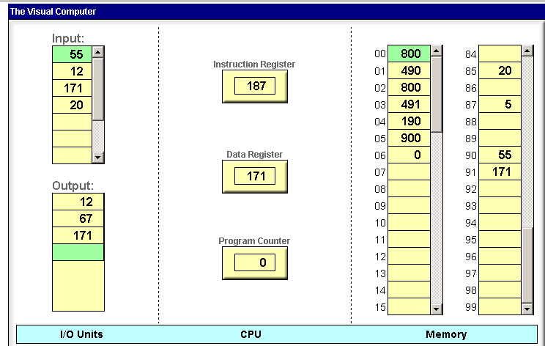

Add operation
symbolic numeric semantics
syntax syntax (meaning)
read 800 D = input
write 900 output = D
load xx 3xx D = M[xx]
store xx 4xx M[xx] = D
add 87
add xx 1xx D = D + M[xx]
sub xx 2xx D = D - M[xx]
(D = the Data register)
following
execution:

Slide 13

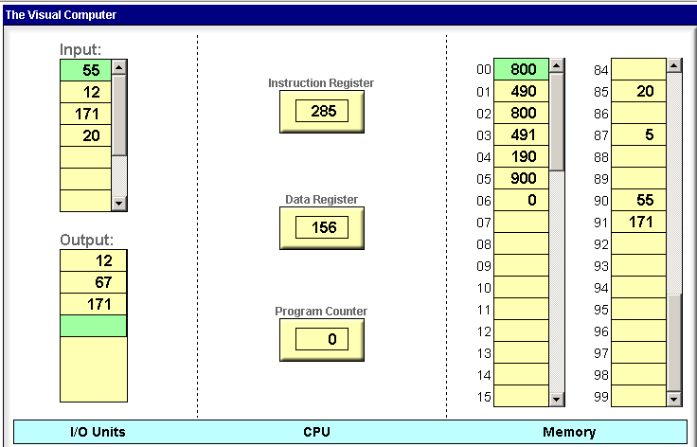
Subtract operation
symbolic numeric semantics
syntax syntax (meaning)
read 800 D = input
write 900 output = D
load xx 3xx D = M[xx]
store xx 4xx M[xx] = D
sub 85
add xx 1xx D = D + M[xx]
sub xx 2xx D = D - M[xx]
(D = the Data register)
following
execution:

Slide 14
Lecture plan
Computer (Vic)
Architecture
Instructions
Low-level programming
Basic
Branching
Control
Program translation
From Vic to a real computer

Slide 15



Low-level programming
Task: read two numbers and write their sum.
pseudocode
High-level thinking…
High-level programming
You think about the code abstractly, with Java or Python in mind,
without worrying about how the machine handles the abstraction.

Slide 16
Low-level programming
Task: read two numbers and write their sum.
pseudocode
int x = read()
int y = read()
print(x + y)
High-level thinking…
High-level programming
You think about the code abstractly, with Java or Python in mind,
without worrying about how the machine handles the abstraction.

Slide 17
Low-level programming
Task: read two numbers and write their sum.
pseudocode
Low-level thinking…
symbolic numeric semantics
syntax syntax (meaning)
Low-level programming
You think about the code mechanically, in terms of machine-level operations.
read 800 D = input
write 900 output = D
load xx 3xx D = M[xx]
store xx 4xx M[xx] = D
add xx 1xx D = D + M[xx]
sub xx 2xx D = D - M[xx]

Slide 18
Low-level programming
Task: read two numbers and write their sum.
pseudocode
symbolic program
executable code
read a number
store it somewhere
read a number
store it somewhere
add the first number
write
stop
00
01
02
03
04
05
06
read
store 90
read
store 91
add 90
write
stop
00
01
02
03
04
05
06
800
490
800
491
190
900
000
Low-level thinking…
implement
translate
symbolic numeric semantics
syntax syntax (meaning)
Low-level programming
You think about the code mechanically, in terms of machine-level operations.
read 800 D = input
write 900 output = D
load xx 3xx D = M[xx]
store xx 4xx M[xx] = D
add xx 1xx D = D + M[xx]
sub xx 2xx D = D - M[xx]

Slide 19
Low-level programming
Task: read two numbers and write their sum.
pseudocode
symbolic program
executable code
read a number
store it somewhere
read a number
store it somewhere
add the first number
write
stop
00
01
02
03
04
05
06
read
store 90
read
store 91
add 90
write
stop
00
01
02
03
04
05
06
800
490
800
491
190
900
000
Low-level thinking…
implement
translate
load
Since instructions can be coded as numbers, we can load them into the machine, and have the machine execute the program’s semantics.
Low-level programming
You think about the code mechanically, in terms of machine-level operations.

Slide 20
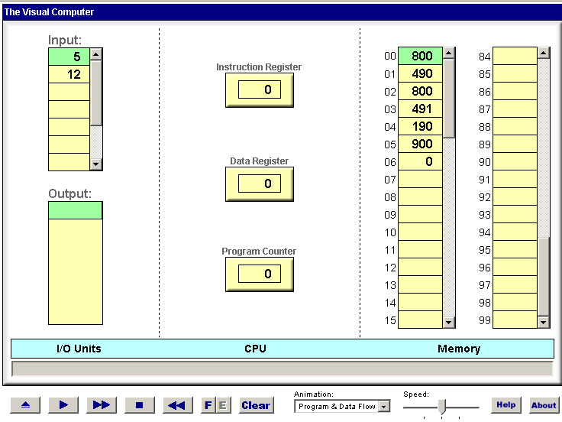

Loading and executing a program
Load the program’s code
following execution:
execute

Slide 21
Loading and executing a program
Fetch-execute cycle:
(basic version)
PC = 0
fetch:
IR = M[PC]
if (IR == 0) stop
execute IR (read, write, load, …)
PC++
goto fetch
How is the fetch-execute logic implemented?
It is hard-wired into the computer hardware (not shown in this lecture).
Who controls the program execution magic?

Slide 22
Lecture plan
Computer (Vic)
Architecture
Instructions
Low-level programming
Basic
Branching
Control
Program translation
From Vic to a real computer

Slide 23
Branching
Default flow of control: linear
Typical flow of control: branching
command
command
command
command
command
command
command
command
command
command
command
command
command
command
command
label a
command
if condition goto b
command
command
label b
command
command
if condition goto c
command
label c
command
goto a

Slide 24
Branching
Low-level branching instruction: goto addr
addr: An address in memory (also, a line number in the program)
goto: Transfers control to the instruction stored in addr
Vic features three branching instructions:
Symbolic Exec. Semantics
goto xx 5xx goto xx
gotoz xx 6xx if (D == 0) goto xx
gotop xx 7xx if (D > 0) goto xx
Task (example): Read and write until 0 is read
0
1
2
3
4
read
gotoz 4
write
goto 0
stop
0
1
2
3
4
800
604
900
500
000
translate
test

Slide 25
Branching
Task: Read two numbers and write the greater one
machine language
read
store x
read
store y
sub x
gotop YISMAX
load x
write
stop
load y
write
stop
0
1
2
3
4
5
6
7
8
9
10
11
...
Branching instructions:
Symbolic Exec. Semantics
goto xx 5xx goto xx
gotoz xx 6xx if (D == 0) goto xx
gotop xx 7xx if (D > 0) goto xx

Slide 26
Branching
Task: Read two numbers and write the greater one
machine language
read
store x
read
store y
sub x
gotop YISMAX 9
load x
write
stop
load y
write
stop
0
1
2
3
4
5
6
7
8
9
10
11
...
Branching instructions:
Symbolic Exec. Semantics
goto xx 5xx goto xx
gotoz xx 6xx if (D == 0) goto xx
gotop xx 7xx if (D > 0) goto xx

Slide 27
Branching
Task: Read two numbers and write the greater one
machine language
read
store x
read
store y
sub x
gotop 9
load x
write
stop
load y
write
stop
0
1
2
3
4
5
6
7
8
9
10
11
...
Branching instructions:
Symbolic Exec. Semantics
goto xx 5xx goto xx
gotoz xx 6xx if (D == 0) goto xx
gotop xx 7xx if (D > 0) goto xx

Slide 28
Branching
Task: Read two numbers and write the greater one
machine language
executable code
read
store x
read
store y
sub x
gotop 9
load x
write
stop
load y
write
stop
Convention: Allocate variables to memory, from address 90 onward:
x: represented by M[90]
y: represented by M[91]
800
490
800
491
290
709
390
900
000
391
900
000
0
1
2
3
4
5
6
7
8
9
10
11
...
0
1
2
3
4
5
6
7
8
9
10
11
...
translate
load
Branching instructions:
Symbolic Exec. Semantics
goto xx 5xx goto xx
gotoz xx 6xx if (D == 0) goto xx
gotop xx 7xx if (D > 0) goto xx

Slide 29
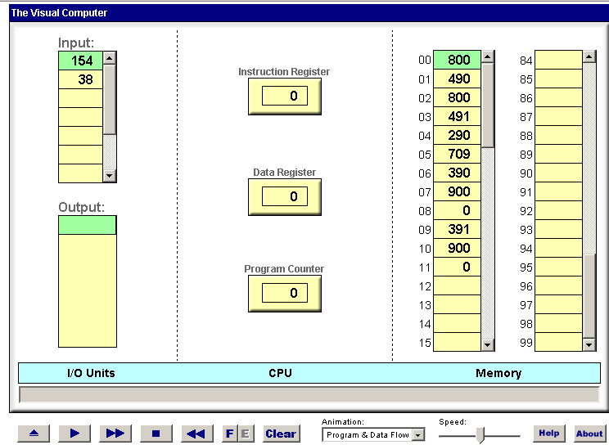
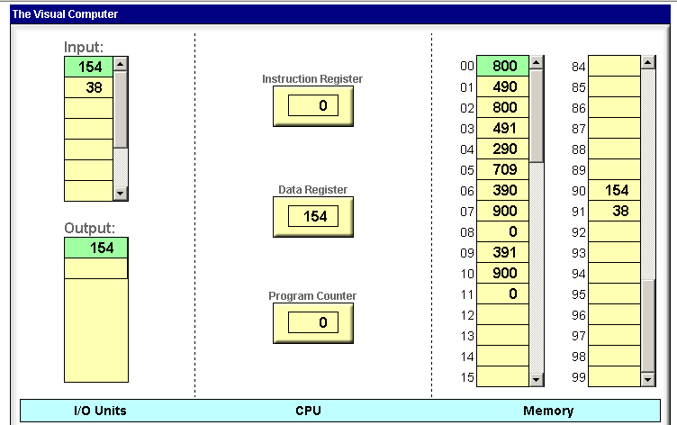
Branching
“max of two numbers” program
Following execution:

Slide 30
Lecture plan
Computer (Vic)
Architecture
Instructions
Low-level programming
Basic
Branching
Control
Program translation
From Vic to a real computer

Slide 31
Fetch–execute cycle
PC = 0
fetch:
IR == M[PC]
if (IR == 0) stop
IR:
D:
PC:
Who controls the program execution magic?

Slide 32
Fetch–execute cycle
PC = 0
fetch:
IR == M[PC]
if (IR == 0) stop
if ( (IR == 5xx) or
(IR == 6xx and D == 0) or
(IR == 7xx and D > 0) )
PC = xx
else
execute IR (read, write, load, store, add, sub)
PC++
goto fetch
IR:
D:
PC:
Who controls the program execution magic?

Slide 33
Fetch–execute cycle
PC = 0
fetch:
IR == M[PC]
if (IR == 0) stop
if ( (IR == 5xx) or
(IR == 6xx and D == 0) or
(IR == 7xx and D > 0) )
PC = xx
else
execute IR (read, write, load, store, add, sub)
PC++
goto fetch
IR:
D:
PC:
That’s it! the description of the Vic computer is now complete.

Slide 34
The Vic computer specification (recap)
I/O
CPU
RAM
symbolic numeric semantics
syntax syntax (meaning)
I/O
Instructions
read 800 D = input
write 900 output = D
memory Instructions
load xx 3xx D = M[xx]
store xx 4xx M[xx] = D
arithmetic Instructions
add xx 1xx D = D + M[xx]
sub xx 2xx D = D - M[xx]
control Instructions
goto xx 5xx goto xx
gotoz xx 6xx if (D == 0) goto xx
gotop xx 7xx if (D > 0) goto xx
Conventions
instruction = 3-digit number
D: data register
xx: 2-digit number
M[xx]: contents of the RAM at address xx

Slide 35
Lecture plan
Computer (Vic)
Architecture
Instructions
Low-level programming
Basic
Branching
Control
Program translation
From Vic to a real computer

Slide 36

Symbolic programming
Symbolic Exec. Semantics
Task: sum up a series of numbers that ends with a zero
Pseudocode
Symbolic program
sum = 0
LOOP:
read x
if (x == 0) goto END
sum = sum + x
goto LOOP
END:
write sum
stop
write
// sum = 0
load zero
store sum
LOOP:
// read x
read
store x
// if (x == 0) goto END
gotoz END
// sum = sum + x
load sum
add x
store sum
goto LOOP
END:
// write sum
load sum
write
stop
Write the code using the symbolic Vic language
Use symbolic variables and symbolic addresses, as needed

Slide 37
Symbolic programming
Symbolic Exec. Semantics
Task: sum up a series of numbers that ends with a zero
Pseudocode
Symbolic program
sum = 0
LOOP:
read x
if (x == 0) goto END
sum = sum + x
goto LOOP
END:
write sum
stop
write
// sum = 0
load zero
store sum
LOOP:
// read x
read
store x
// if (x == 0) goto END
gotoz END
// sum = sum + x
load sum
add x
store sum
goto LOOP
END:
// write sum
load sum
write
stop
Write the code using the symbolic Vic language
Use symbolic variables and symbolic addresses, as needed
Let’s remove the white space, and add line numbers

Slide 38
Program translation
Task: sum up a series of numbers that ends with a zero
Pseudocode
Symbolic program
sum = 0
LOOP:
read x
if (x == 0) goto END
sum = sum + x
goto LOOP
END:
write sum
stop
write
0
1
2
3
4
5
6
7
8
9
10
11
load zero
store sum
LOOP:
read
store x
gotoz END
load sum
add x
store sum
goto LOOP
END:
load sum
write
stop

Slide 39
Program translation
Task: sum up a series of numbers that ends with a zero
Pseudocode
Symbolic program
sum = 0
LOOP:
read x
if (x == 0) goto END
sum = sum + x
goto LOOP
END:
write sum
stop
write
0
1
2
3
4
5
6
7
8
9
10
11
load zero
store sum
LOOP:
read
store x
gotoz END
load sum
add x
store sum
goto LOOP
END:
load sum
write
stop
Symbol table:
zero: 98 (predefined)
one: 99 (predefined)
sum: 90
x: 91
LOOP: 2
END: 9
Construct a symbol table:
Maps every symbol in the code to an (agreed-upon) memory address

Slide 40
Program translation
Task: sum up a series of numbers that ends with a zero
Pseudocode
Symbolic program
Executable code
sum = 0
LOOP:
read x
if (x == 0) goto END
sum = sum + x
goto LOOP
END:
write sum
stop
write
load zero
store sum
LOOP:
read
store x
gotoz END
load sum
add x
store sum
goto LOOP
END:
load sum
write
stop
translate
0
1
2
3
4
5
6
7
8
9
10
11
398
490
800
491
609
390
191
490
502
390
900
000
Symbol table:
zero: 98
one: 99
sum: 90
x: 91
LOOP: 2
END: 9
Use the symbol table to translate symbolic variables and symbolic goto destinations to numeric addresses.

Slide 41
Program translation
Task: sum up a series of numbers that ends with a zero
Pseudocode
Symbolic program
Executable code
sum = 0
LOOP:
read x
if (x == 0) goto END
sum = sum + x
goto LOOP
END:
write sum
stop
write
load zero
store sum
LOOP:
read
store x
gotoz END
load sum
add x
store sum
goto LOOP
END:
load sum
write
stop
translate
0
1
2
3
4
5
6
7
8
9
10
11
398
490
800
491
609
390
191
490
502
390
900
000
Symbol table:
zero: 98
one: 99
sum: 90
x: 91
LOOP: 2
END: 9
Observations
Compared to executable code, symbolic code is much easier to write / debug / maintain.
The translation process can be automated.

Slide 42

Program translation
Task: sum up a series of numbers that ends with a zero
Pseudocode
Sum.asm
Sum.vic
sum = 0
LOOP:
read x
if (x == 0) goto END
sum = sum + x
goto LOOP
END:
write sum
stop
write
load zero
store sum
LOOP:
read
store x
gotoz END
load sum
add x
store sum
goto LOOP
END:
load sum
write
stop
translate
398
490
800
491
609
390
191
490
502
390
900
000
Use an editor
to write a program using the Vic assembly language
Use an assembler
to translate the program into executable code

Slide 43
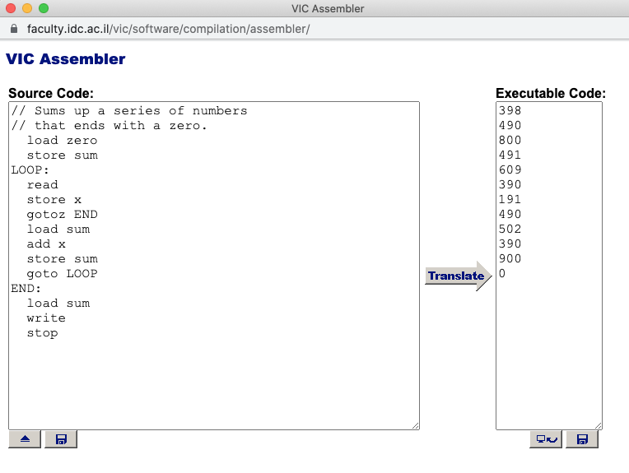
Program translation: Vic
Task: sum up a series of numbers that ends with a zero
2
1
Load an .asm file
3
Load the resulting .vic file into the Vic computer

Slide 44
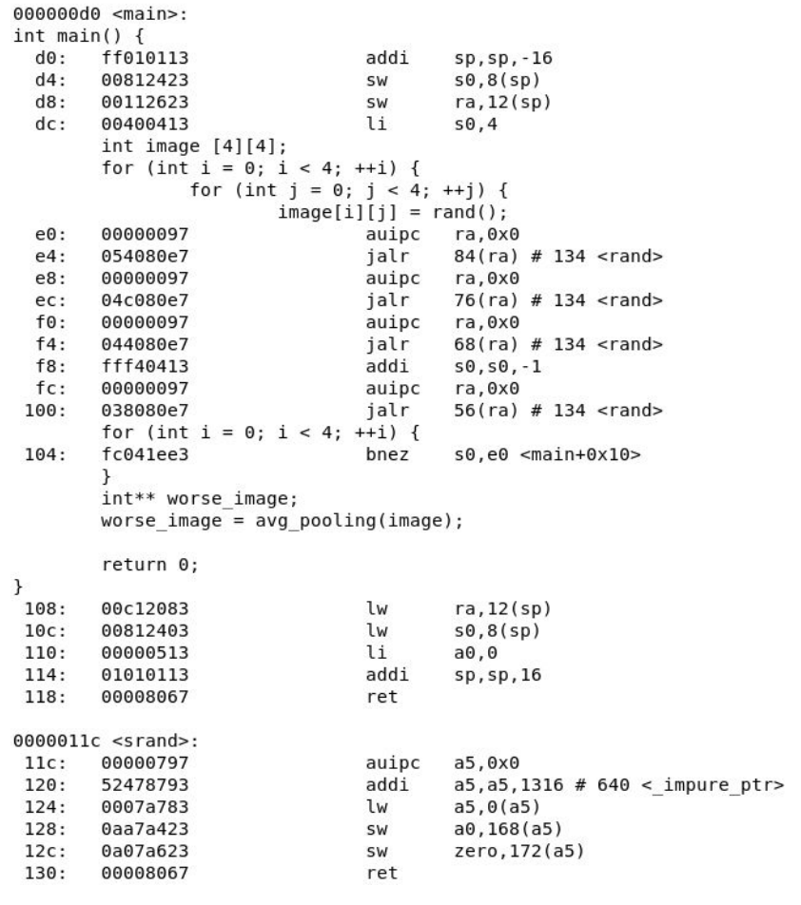
Program translation: C
C program
(typical 2D array processing)

Slide 45
Program translation: C
Translated to RISC-V, a machine language used in many modern computers
. . .
1
2
3
Shows the compiled code generated by a C compiler:
1: RAM address (in hexa)
2: Binary instructions (in hexa)
3: Symbolic instructions (op code, followed by parameters)

Slide 46
Lecture plan
Computer (Vic)
Architecture
Instructions
Low-level programming
Basic
Branching
Control
Program translation
From Vic to a real computer

Slide 47


From Vic to the real thing
Suppose we have unlimited supplies of money, time, and creativity;
How can we evolve Vic into a real computer?

Slide 48
Computer architecture
Vic Typical PC
1 data register ……………… 32 data registers
3-digit words ....................... 64-bit words
100 memory cells ………….. billions of memory cells
1 memory unit ……………… RAM, ROM, cache
No secondary storage ………. disk
1 input unit ………………… keyboard, mouse, disk, modem, …
1 output unit………………… screen, speakers, disk, network, …
1 “computer”……………….. CPU + various I/O processors, one for each I/O device
10 instructions ……………... 100-300 instructions
1 program …………………. several programs running “simultaneously”
1 instruction per cycle …….. parallel processing.
I/O
CPU
RAM
Implementing any one of these improvements is a straightforward extension of the basic Vic architecture.

Slide 49
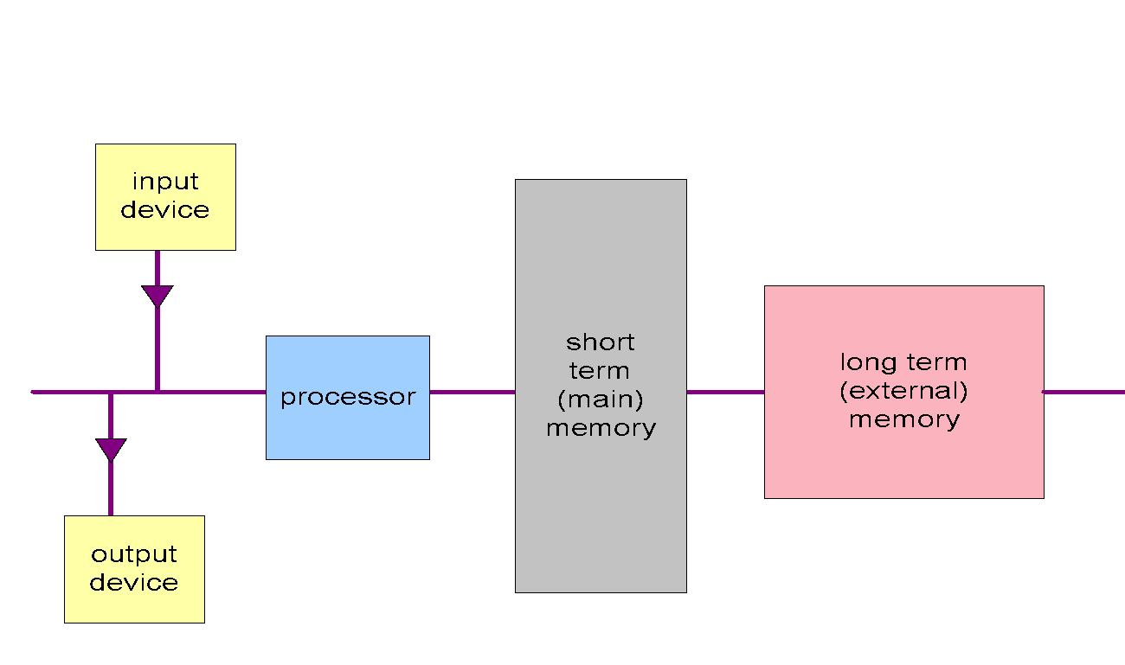
Computer architecture
All computers are based on variations of this basic model

Slide 50
Computer architecture
I/O devices
main memory
external
network
storage
backbone
scanner
mouse
system programs
memory stick
processing
devices
keyboard
processing
app1
hard disks
devices
app2
unused area
Cache
memory
app3
bus
processor
processor
processors
file 1 (paged)
unused area
file 2 (paged)
speakers
network
printer
file 3 (paged)
interface
card
screen
unused area
All computers are based on variations of this basic model

Slide 51
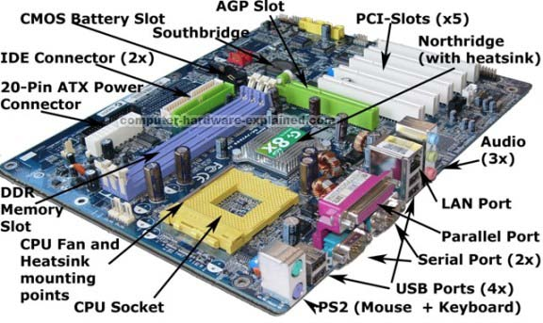
Computer architecture
Thanks goodness for abstractions!
Computer Science (CS): Focuses on logical operations
Electrical engineering (EE): Focuses on physical implementations
Remember: Vic is just a simple metaphor

